Slide 1

AdaBoost and Gradient Boost

Slide 2
Boosting
The principle behind boosting algorithms is first we built a model on the training dataset, then a second model is built to rectify the errors present in the first model.
This procedure is continued until and unless the errors are minimized, and the dataset is predicted correctly.
Let’s take an example to understand this, suppose you built a decision tree algorithm on the Titanic dataset and from there you get an accuracy of 80%.
After this, you apply a different algorithm and check the accuracy and it comes out to be 75% for KNN and 70% for Linear Regression.

Slide 3
Boosting
Boosting algorithms works in a similar way, it combines multiple models (weak learners) to reach the final output (strong learners).
There are mainly 3 types of boosting algorithms:
AdaBoost algorithm
Gradient descent algorithm
Xtreme gradient descent algorithm

Slide 4
AdaBoost
AdaBoost also called Adaptive Boosting is a technique in Machine Learning used as an Ensemble Method.
The most common algorithm used with AdaBoost is decision trees with one level that means with Decision trees with only 1 split. These trees are also called Decision Stumps.
it builds a model and gives equal weights to all the data points. It then assigns higher weights to points that are wrongly classified.
Now all the points which have higher weights are given more importance in the next model. It will keep training models until and unless a lowe error is received.

Slide 5
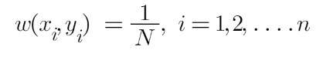
AdaBoost
Step 1 – The Image is shown below is the actual representation of our dataset. Since the target column is binary it is a classification problem. First of all these data points will be assigned some weights. Initially, all the weights will be equal.
The formula to calculate the sample weights is:
Where N is the total number of datapoints.
Here since we have 5 data points so the sample weights assigned will be 1/5.

Slide 6
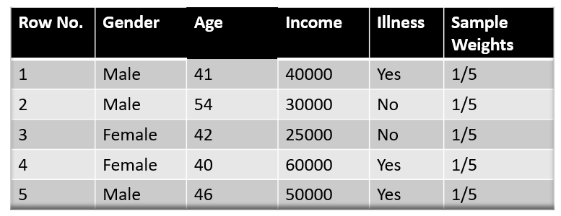
AdaBoost

Slide 7
AdaBoost
Step 2 – We start by seeing how well “Gender” classifies the samples and will see how the variables (Age, Income) classifies the samples.
We’ll create a decision stump for each of the features and then calculate the Gini Index of each tree. The tree with the lowest Gini Index will be our first stump.
Here in our dataset let’s say Gender has the lowest gini index so it will be our first stump.

Slide 8
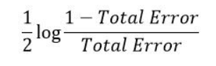
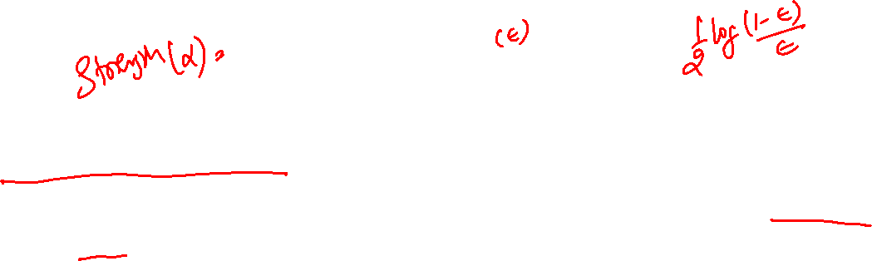
AdaBoost
Step 3 – We’ll now calculate the “Amount of Say” or “Importance” or “Influence” for this classifier in classifying the datapoints using this formula:
The total error is nothing, but the summation of all the sample weights of misclassified data points.
Here in our dataset let’s assume there is 1 wrong output, so our total error will be 1/5, and alpha(performance of the stump) will be:

Slide 9
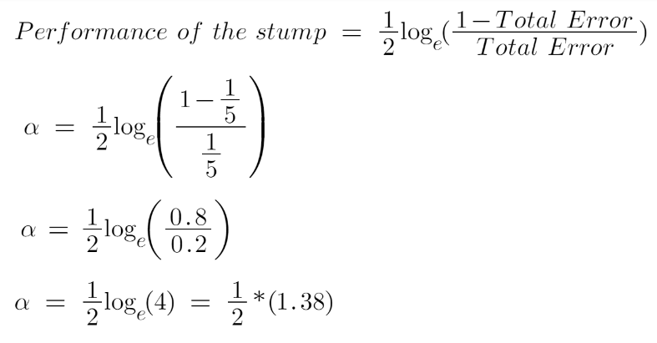
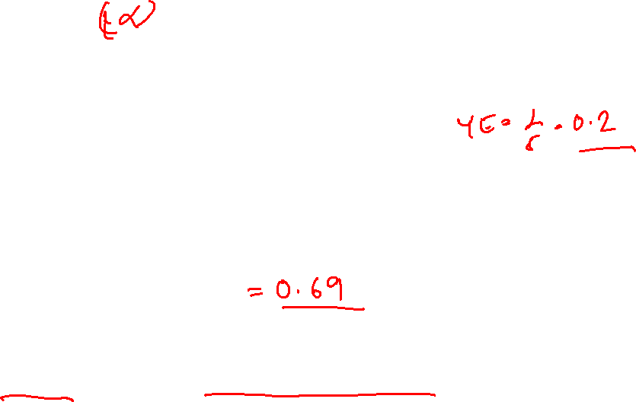
AdaBoost
Note: Total error will always be between 0 and 1.
0 Indicates perfect stump and 1 indicates horrible stump.

Slide 10
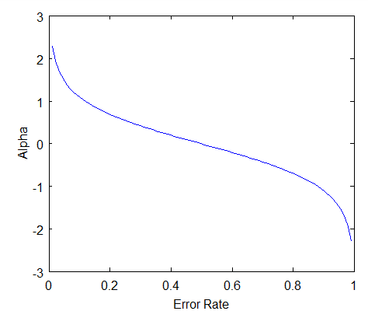
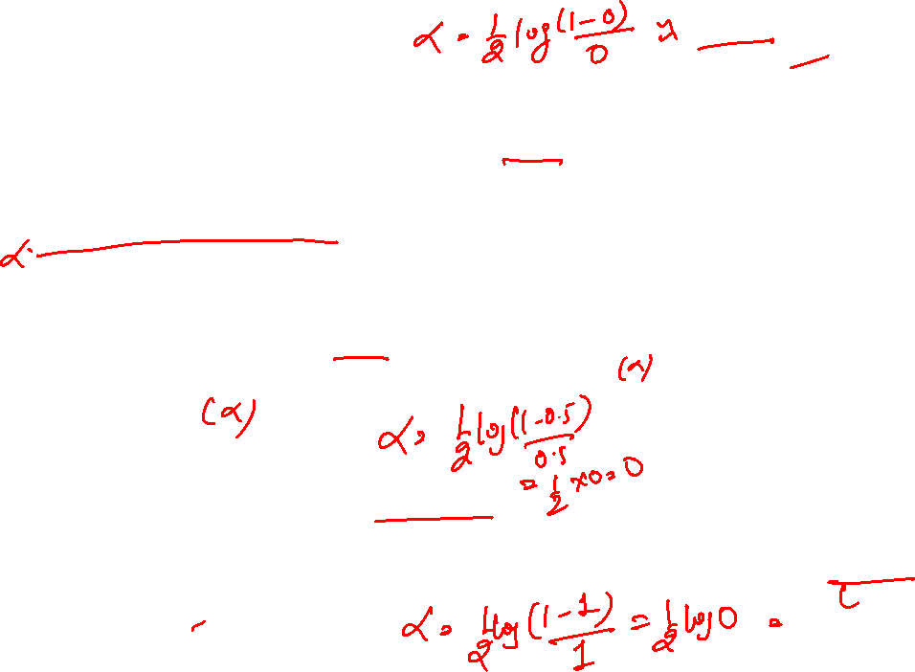
From the graph above we can see that when there is no misclassification then we have no error (Total Error = 0), so the “amount of say (alpha)” will be a large number.
When the classifier predicts half right and half wrong then the Total Error = 0.5 and the importance (amount of say) of the classifier will be 0.
If all the samples have been incorrectly classified, then the error will be very high (approx. to 1) and hence our alpha value will be a negative integer.

Slide 11
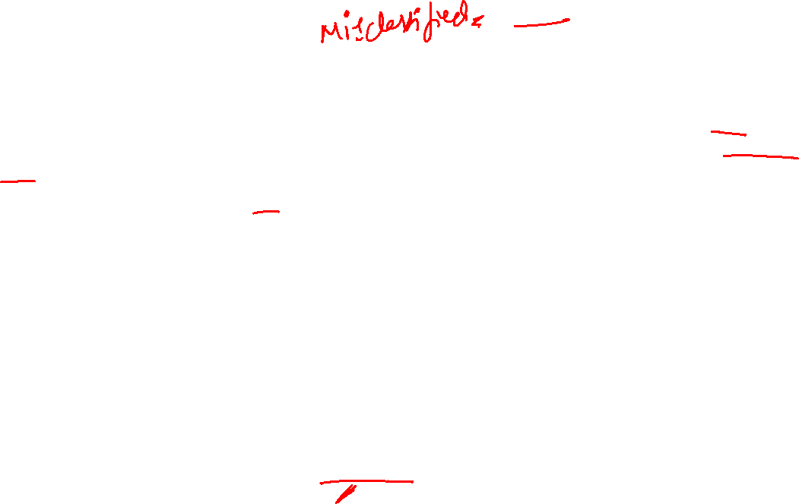
AdaBoost
Step 4 – You must be wondering why is it necessary to calculate the TE and performance of a stump? Well, the answer is very simple, we need to update the weights because if the same weights are applied to the next model, then the output received will be the same as what was received in the first model.
The wrong predictions will be given more weight whereas the correct predictions weights will be decreased. Now when we build our next model after updating the weights, more preference will be given to the points with higher weights.
After finding the importance of the classifier and total error we need to finally update the weights and for this, we use the following formula:

Slide 12
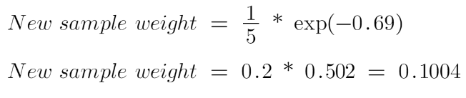
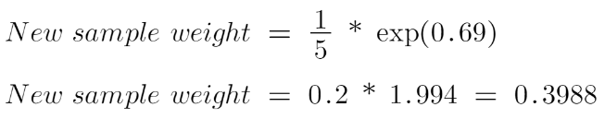
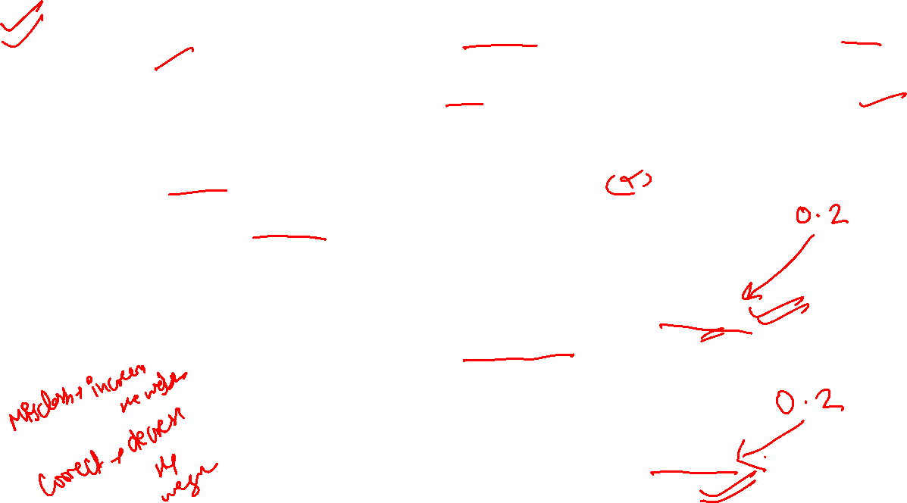
The amount of say (alpha) will be negative when the sample is correctly classified.
The amount of say (alpha) will be positive when the sample is miss-classified.
There are four correctly classified samples and 1 wrong, here the sample weight of that datapoint is 1/5 and the amount of say/performance of the stump of Gender is 0.69.
New weights for correctly classified samples are:
For wrongly classified samples the updated weights will be:

Slide 13
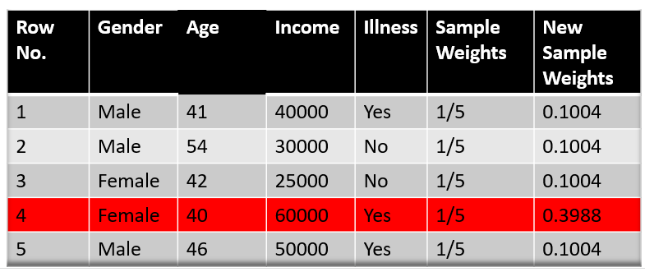
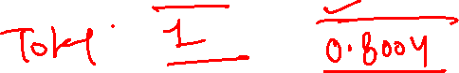
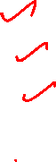
Note: See the sign of alpha when I am putting the values, the alpha is negative when the data point is correctly classified, and this decreases the sample weight from 0.2 to 0.1004. It is positive when there is misclassification, and this will increase the sample weight from 0.2 to 0.3988

Slide 14
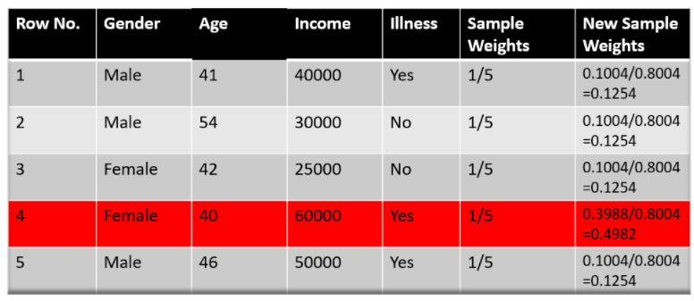
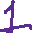
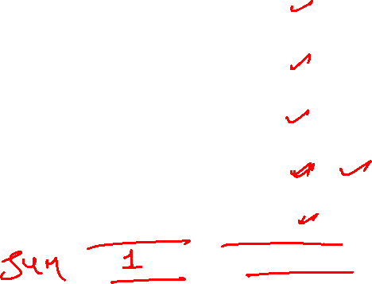
We know that the total sum of the sample weights must be equal to 1 but here if we sum up all the new sample weights, we will get 0.8004. To bring this sum equal to 1 we will normalize these weights by dividing all the weights by the total sum of updated weights that is 0.8004. So, after normalizing the sample weights we get this dataset and now the sum is equal to 1.

Slide 15
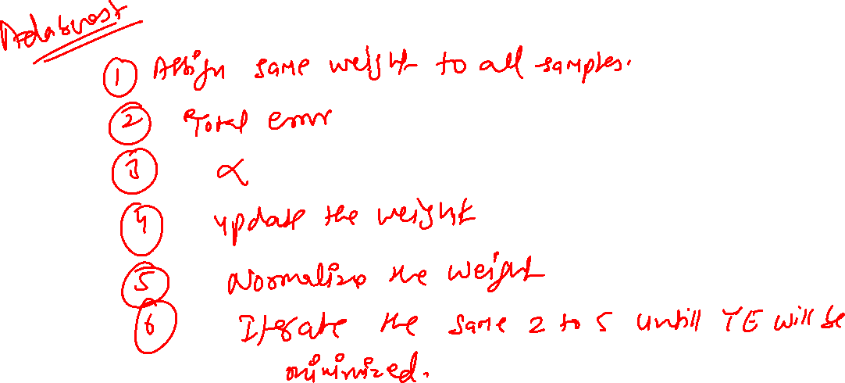

Slide 16
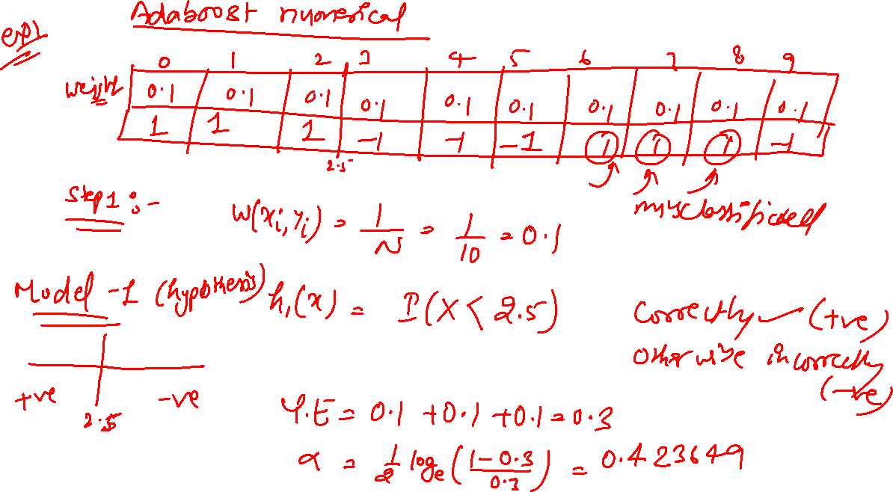

Slide 17
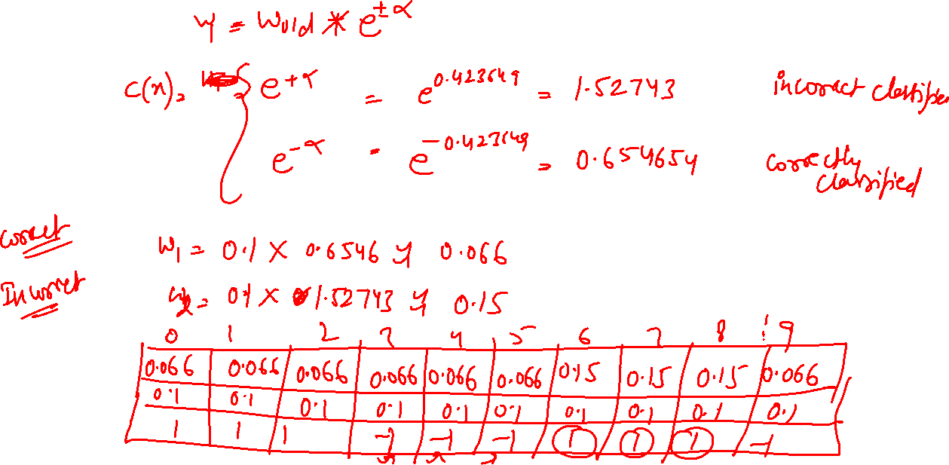
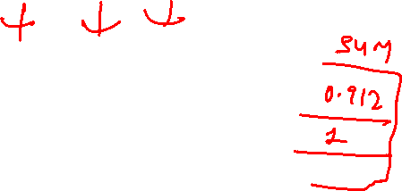

Slide 18
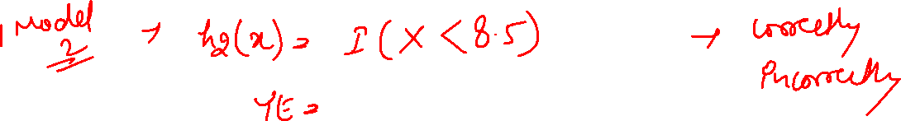
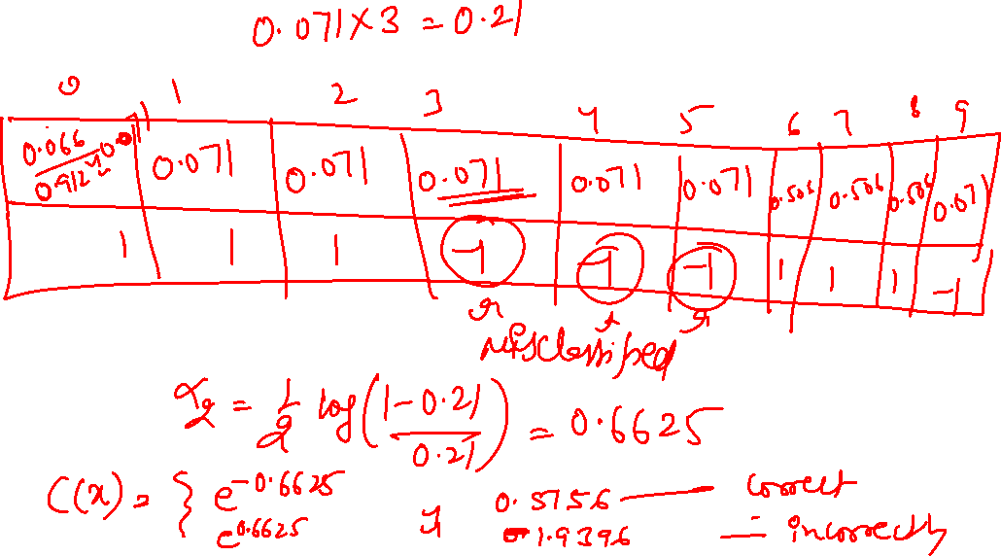

Slide 19
